Slide 1

Sentence Autocomplete
Presented by
M. Sai Prathap Reddy
H.L. Jaya Murugan

Slide 2


Sentence Autocomplete: A Deep Dive
Sentence Autocomplete is a technology that predicts and suggests the next word in a sentence. This technology is commonly used in text editors, search engines, and chatbots.

Slide 3
Basic Computation Concepts
Finite Automata
Markov Models
Finite Automata (FA) are mathematical models used to represent state machines. They consist of a finite set of states and transitions between those states.
Markov Models are probabilistic models that predict the next state based on the current state. They are closely related to FAs as they also rely on state transitions.

Slide 4

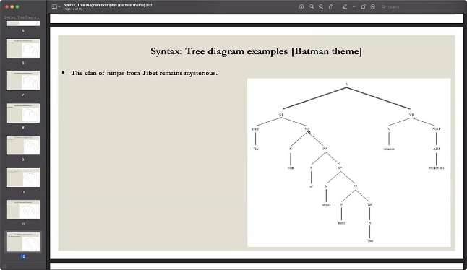
Advanced Theoretical Concepts
1
Context-Free Grammars (CFGs)
2
Chomsky Hierarchy
The Chomsky Hierarchy classifies different types of formal grammars based on their expressive power. CFGs are placed in the second level of the hierarchy, indicating their ability to handle more complex language structures than regular grammars.
CFGs are a formal system used to describe the structure of sentences. They define rules for combining words into phrases and clauses, allowing for more complex sentence structures.

Slide 5

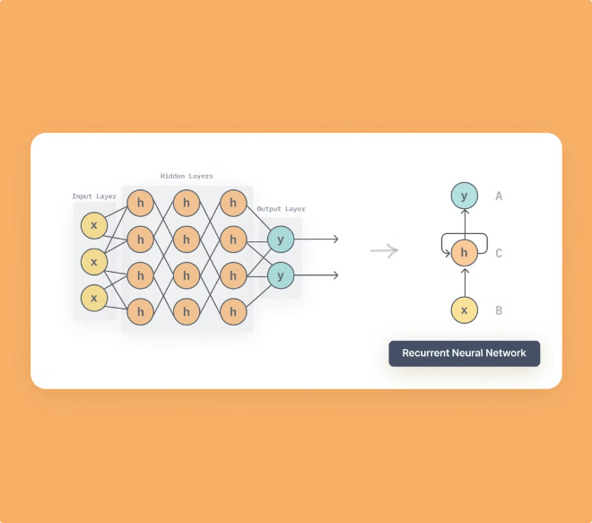


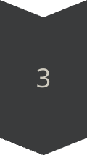
Recurrent Neural Networks (RNNs)
Beyond Simple Models
RNNs are powerful neural networks designed to handle sequences. They excel at tasks like language modeling because they can process input sequences of varying lengths and capture long-term dependencies.
RNN Structure
RNNs consist of recurrent units that process input sequentially, maintaining a hidden state that represents the context of the previous input. This allows them to learn complex patterns and relationships in language.
Sentence Autocomplete with RNNs
RNNs have proven very effective in sentence autocomplete tasks. They can learn to predict the next word in a sentence based on the preceding words, effectively capturing the context and flow of language.

Slide 6


Complexity
Training Data
Computational Resources
RNNs require massive amounts of training data to learn accurate representations of language. This data is often collected from real-world text sources like books, articles, and websites.
Training RNNs is computationally expensive and requires specialized hardware like GPUs. The model's complexity and the size of the training dataset significantly impact training time.
Model Optimization
Fine-tuning the model's hyperparameters and architecture is crucial for achieving optimal performance. This involves experimenting with different parameter values and network configurations.

Slide 7


Conclusion
Finite Automata & Markov Models
Provide a foundation for understanding basic language modeling.
Context-Free Grammars
Enable the modeling of more complex sentence structures.
Recurrent Neural Networks
Offer a powerful approach to learning language patterns and predicting the next word.

Slide 8


